Slide 1
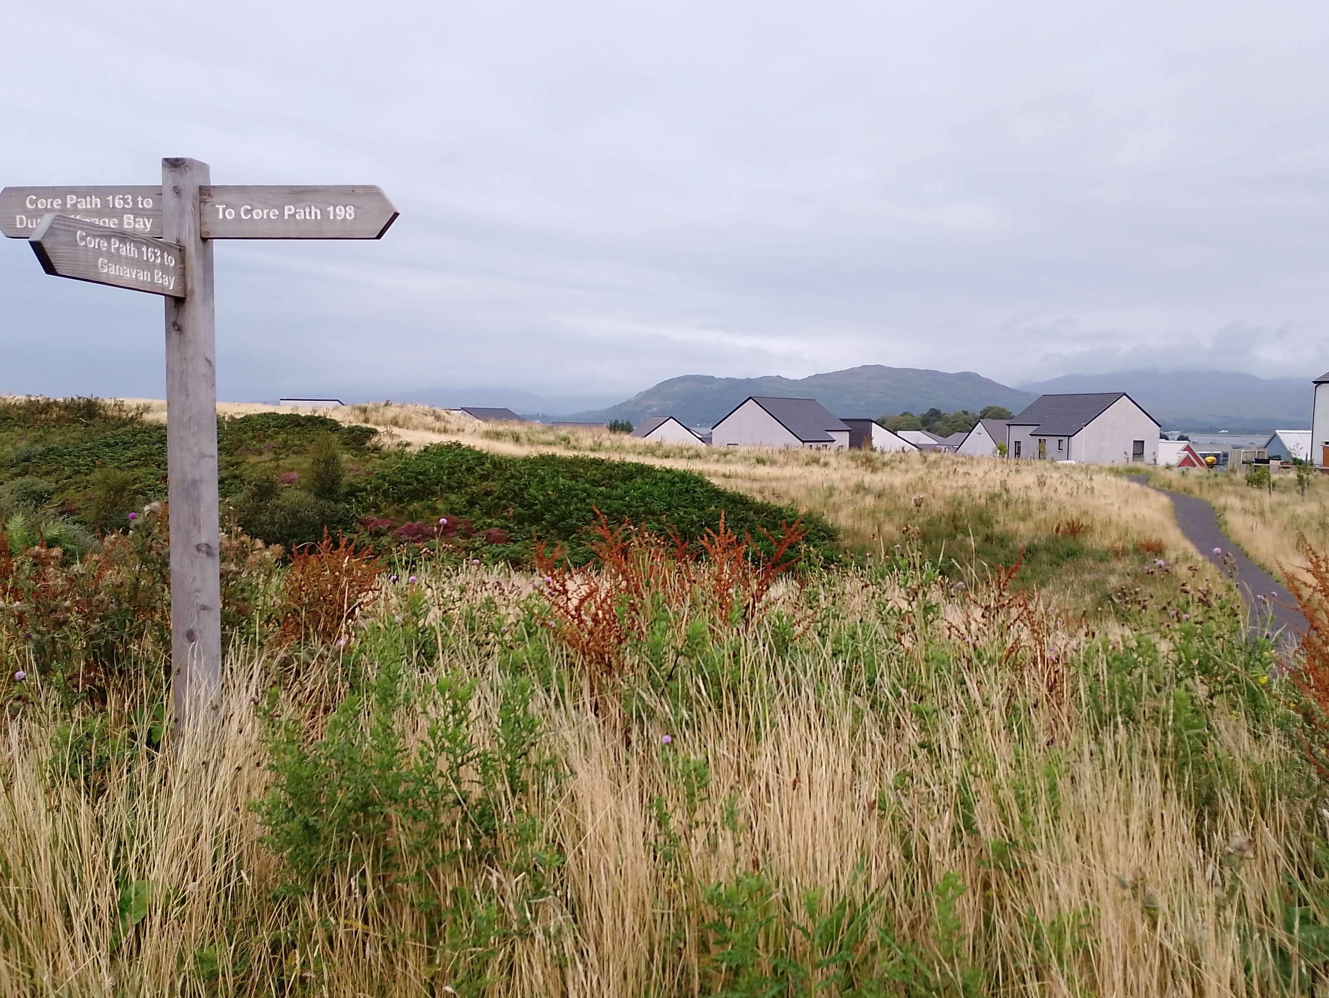
Our approach to participation
Taking Action on Rural Poverty
Becky Hothersall, Development Officer – Argyll & Bute
@PovertyAlliance
www.povertyalliance.org

Slide 2
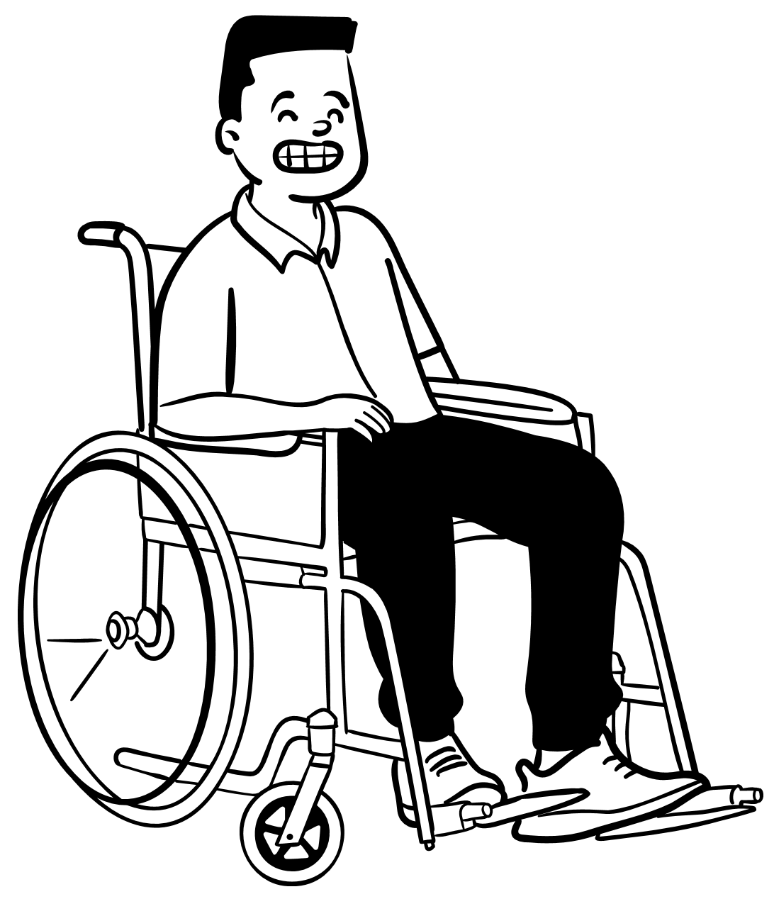
Why Participation?
Better understanding of different parts of the community
Improved decision making
Identifies potential road-blocks to implementation
Improved outcomes for all

Slide 3
Effective participation is:
Resourced and institutionalized
Financial resource, structure for implementation and staffing
Respectful
Keep people fully informed and involved, build relationships and recognise the work
Meaningful
How does it benefit the participant? Clear parameters; track the impact

Slide 4
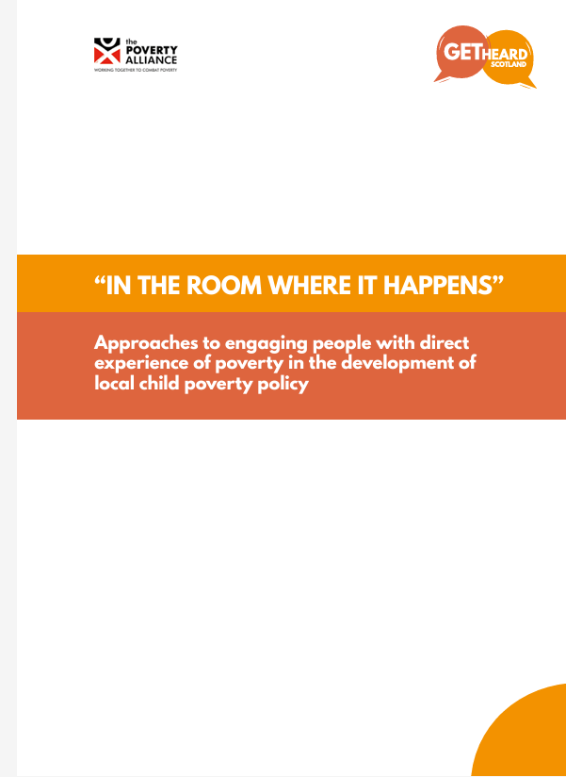
A balancing act
Knowledge
People understand local experiences alongside statistics
Action
More than just being heard
Consciousness
Reflecting on power; learning from others’ perspectives

Slide 5
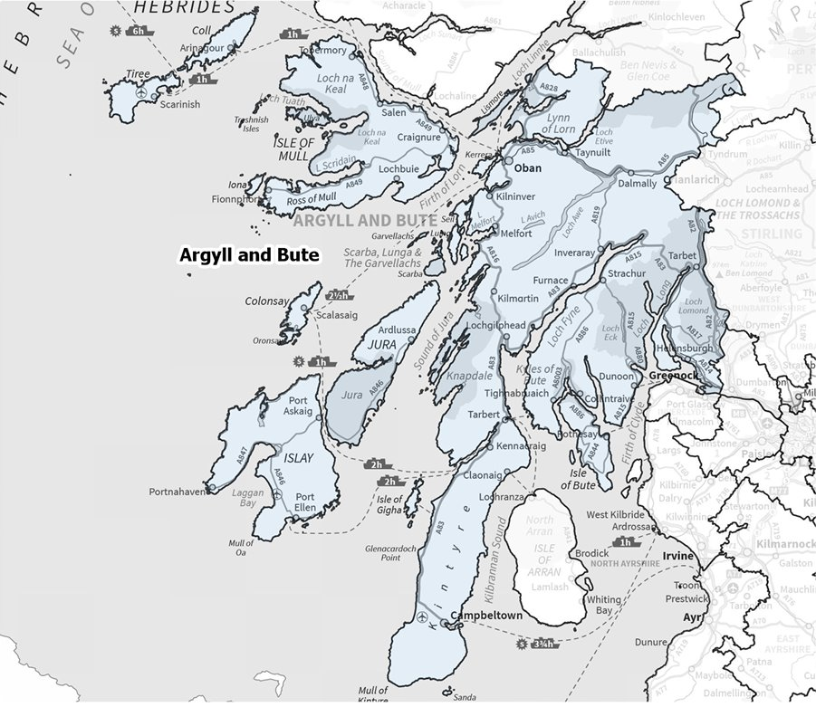
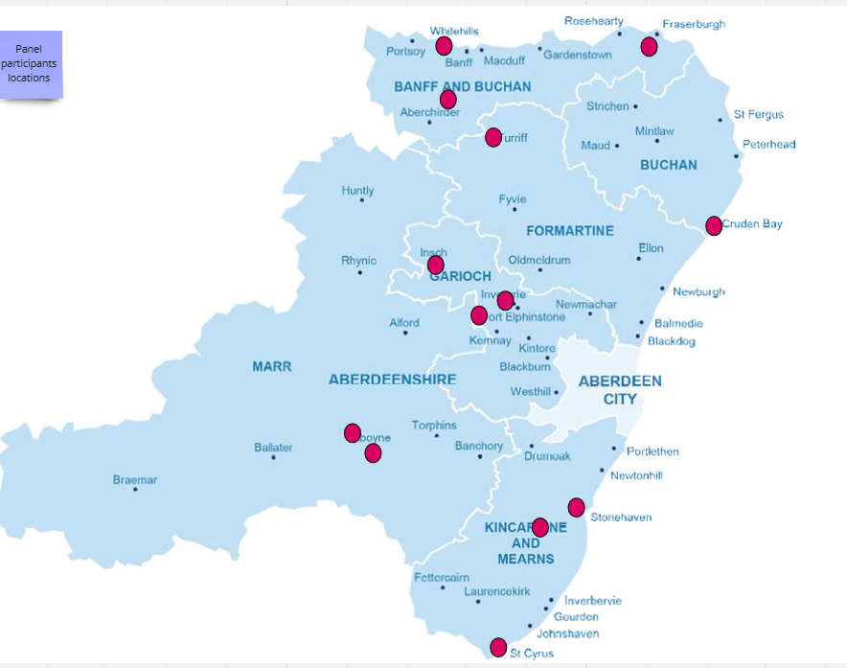
Taking Action on Rural Poverty: citizens’ panels
Argyll & Bute
Aberdeenshire

Slide 6
Rural considerations
Everybody knows everybody
Stigma
Geography
Support
Time
Distance
Weather
Connectivity

Slide 7
Adaptations
Access to data, device or space
Differences
Panellists identified better vouchers
Experience of participation processes
1:1 vs group follow-up
Flexible approach to childcare

Slide 8
What have we been doing?
Co-designing processes, guidelines, evaluation
Identifying and exploring cost of living issues and solutions
Getting inspired about what’s possible
Providing insights to support local funding priorities and support

Slide 9
What’s next?
- Helping select Test of Change projects
- Meeting the First Minister!
- Developing skills
- Working towards being “in the room” when decisions are made
An open invitation to talk to our panels…
Becky.Hothersall@povertyalliance.org (Argyll and Bute)
Anne.McCormack@povertyalliance.org (Aberdeenshire)

