Slide 1
Challenging Rural Poverty in Scotland
Nicky Bowman, Research Officer
povertyalliance.org
@povertyalliance

Slide 2
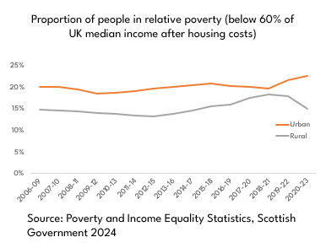
Why we need to focus on rural poverty
Poverty has been framed as a predominantly urban issue
Poverty measures do not account for higher living costs in rural areas
povertyalliance.org
@povertyalliance

Slide 3
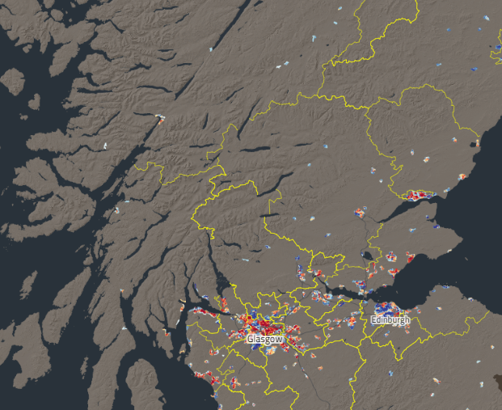
Why we need to focus on rural poverty
Poverty is masked by the rural idyll
Stigma and shame create barriers to support
povertyalliance.org
@povertyalliance

Slide 4
The rural poverty premium
Travel
Fuel Poverty
Higher food prices
Housing Insecurity
The minimum cost of living in rural Scotland is between 14-32% higher than urban areas of the UK.
People living rurally and on a low income are faced with both the rural premium and the poverty premium.
povertyalliance.org
@povertyalliance

Slide 5
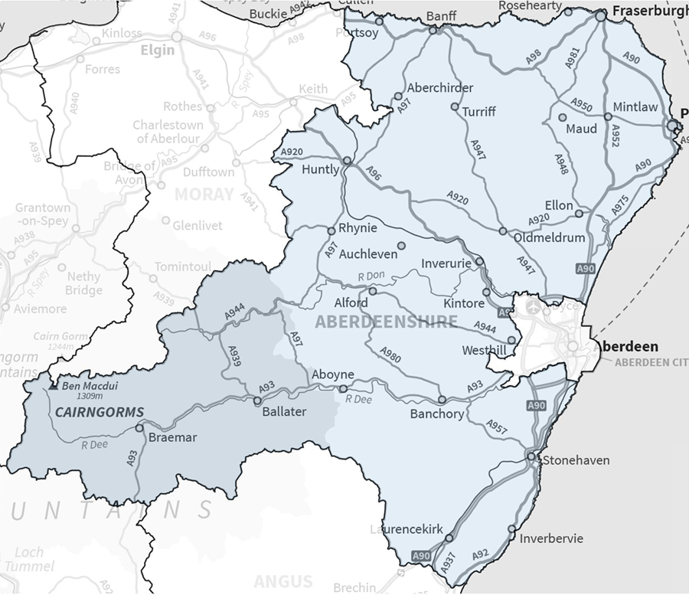
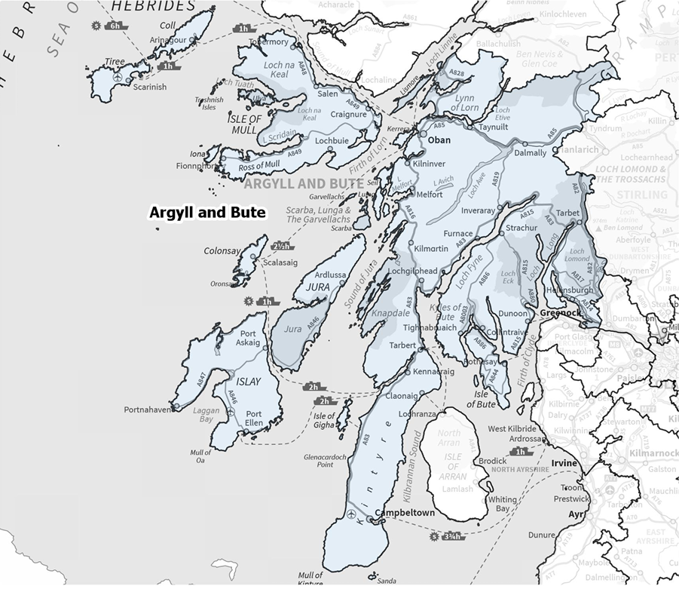
Taking Action on Rural Poverty (TARP)
Taking a systems change approach to reducing the rural poverty premium in Argyll and Bute and Aberdeenshire
povertyalliance.org
@povertyalliance

Slide 6
TARP: Key Objectives
Collaborate
Strengthen
Learn
povertyalliance.org
@povertyalliance

Slide 7
Key Issues: Transportation
“I left a higher paid (permanent) role in [city] as the travel costs…were becoming unaffordable - I was spending in excess of £80 a week on fuel for my car …my lower paid temporary role has left us better off as it's fully remote.”
Travel can add over £50 per week to costs for rural households.
(Scottish Government, Poverty in Rural Scotland: A Review of the Evidence, 2021)
povertyalliance.org
@povertyalliance

Slide 8
Key Issues: Accessing Health Services
“You can claim mileage back, but its not well advertised, its difficult to do and you have to do it within a month”
“Even the local hospital has reduced its hours meaning you have to travel to A&E in (city) if you have an injury.”
povertyalliance.org
@povertyalliance

Slide 9
Key Issues: Food Insecurity
Local community stores costs in rural and island areas were 44% higher on the mainland and 27% higher on islands than the equivalent in a supermarket.
(Scottish Government, Poverty in Rural Scotland: A Review of the Evidence, 2021)
“Food - not only the cost of food but also the cost of going to get food…and fuel (I feel like I am never out the petrol stations) but the cost of transport around here is not much better.”
povertyalliance.org
@povertyalliance

Slide 10
Key Issues: Fuel Poverty
“…if living off the main supply areas for mains gas, a very important difference in costs are that fuels have to be manually monitored for quantity and these fuels come at a premium cost to the household in that they have to be paid for in full before delivery and at a major outlay due to the minimum order quantities.”
35% of remote rural households were classified as extreme fuel poor.
(Scottish Government, Scottish House Conditions Survey, 2022)
povertyalliance.org
@povertyalliance

Slide 11
Key Issues: Housing Security
“When I was younger, you were able to move around more, and it could help you to get better jobs or get opportunities. But now, because the cost of housing is so high, you can't actually move around, especially younger people. It's much more difficult. I think it holds people back in developing their careers and their lives as well.”
There are 3,000 second homes in Argyll and Bute - 6.2% of the overall council tax register. This is higher than any other local authority in Scotland and much higher than the national average of 0.9%.
(Argyll and Bute Council, June 2023)
povertyalliance.org
@povertyalliance

Slide 12
Key Issues: Childcare
“[Childcare] is a big problem in this area. There are no spaces for childcare so at the moment I've just gone back to work part-time. I was full-time before I had my baby and I've come back part-time just because I can't get childcare. My sister watches my child two days a week so that I can work but if she wasn't able to do that, I couldn't go back at all.”
povertyalliance.org
@povertyalliance

Slide 13
Thank you!
nicola.bowman@povertyalliance.org
povertyalliance.org
@povertyalliance

